Slide 1

INTEGRATED CRICKET APP
GROUP TWO
2.Abhinav g s
18.Aravindsagar p a
66.Vishnu p

Slide 2
Contents
Introduction
Products considered
Motivation
General features
Product details
General modifications required
Conclusion

Slide 3
Introduction
Everyone is always keen to know which app is best for live cricket and cricket scores and streaming it online. Here we analyze three products in detail and identify the pros and cons of each product.

Slide 4



Products considered
Cricbuzz
Dream11
Hotstar

Slide 5
Motivation
It is difficult for the user to switch between match fixtures ,live stream and play fantasy cricket league simultaneously. This motivated us in selecting this topic.

Slide 6
General Features
Live score, match updates
Relevant notifications for upcoming events
On-demand sports video
Booking tickets
Social media integrations
Special content for major tournaments
Highlights of games
Checking for seat availability
Stats & news

Slide 7

Product details

Slide 8


Slide 9
About
CricBuzz is an Indian cricket news website owned by Times Internet.
It provides with fast, reliable and accurate cricket updates of all live cricket news, international cricket matches and cricket leagues all around the world.
CricBuzz was created by Pankaj Chhaparwal and Pravin Hegde in 2004.

Slide 10
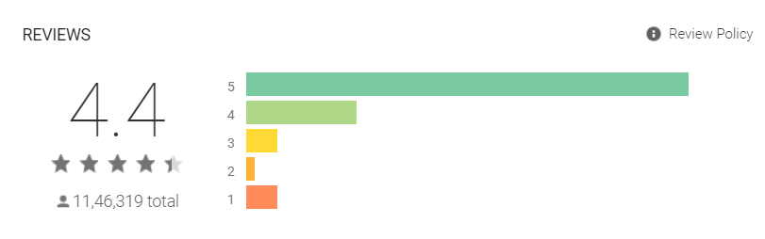
Rating It is a highly rated app

Slide 11
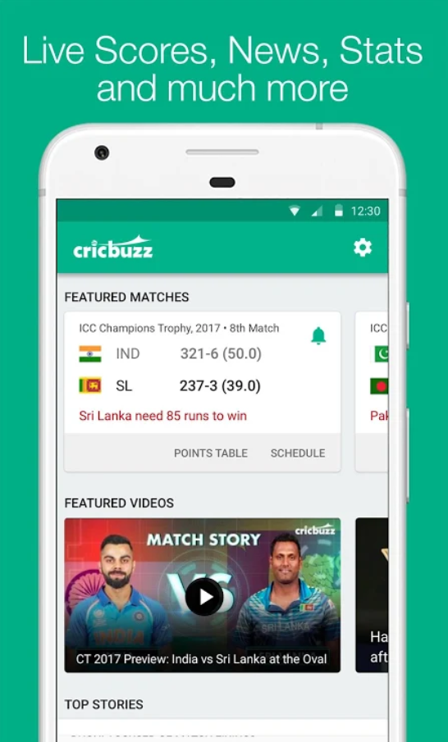
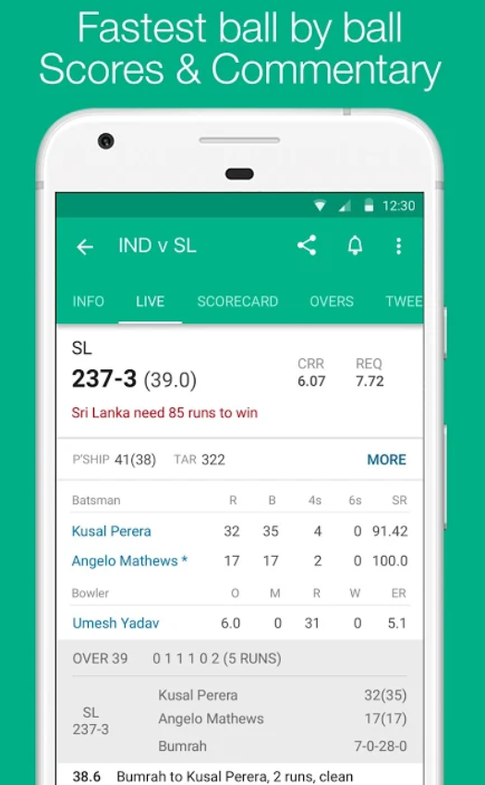
Features
Provides live scorecard of matches

Slide 12
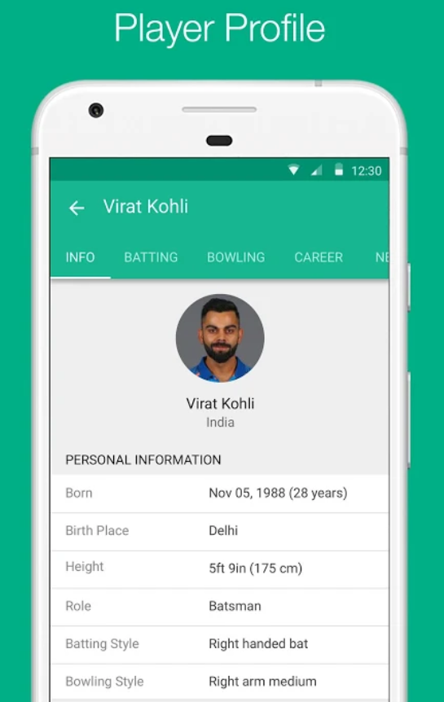
Provides player details

Slide 13
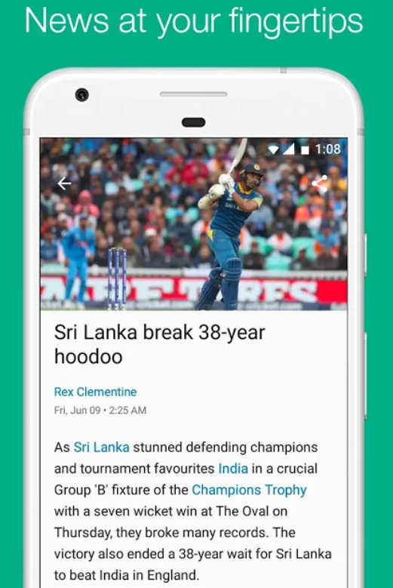
Provides news, articles about the game

Slide 14
Other features
Provides commentary of live matches
Provides pre match and post match shows
Contains archives and details of previously finished games
Contains dark mode

Slide 15
Pros
It is fast and accurate
Easy to use
Very little delay between real time match and scorecards
Provides fixtures for upcoming matches
Instantly updates player profiles and team rankings
High definition images
Excellent map view of all matches
Provides information on wide array of league matches
Can show scores of multiple simultaneously running games
Quick access from widgets

Slide 16
Cons
No voice commentary is available
No lite version of the app is available
No live streaming option available
Notifications or reminders for the game are not accurate
No pin to screen option available
Contains large amount of ads
Highlights of the game is not available
App may stop updating scores for a while in rare occasions

Slide 17


Slide 18
About
Dream11 is an online Fantasy sports website where its users can play fantasy football and cricket leagues with their self created team. You get to play with your dream team of 11 and win cash prizes.
Dream11 was co-founded by Harsh Jain and Bhavit Sheth in 2008.
Dream11 was also recognised as one of the top 10 innovative companies in India by Fast company in 2019.

Slide 19
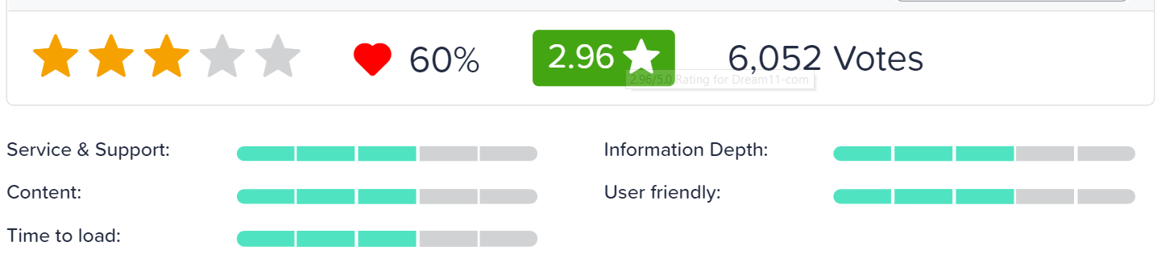
Rating

Slide 20
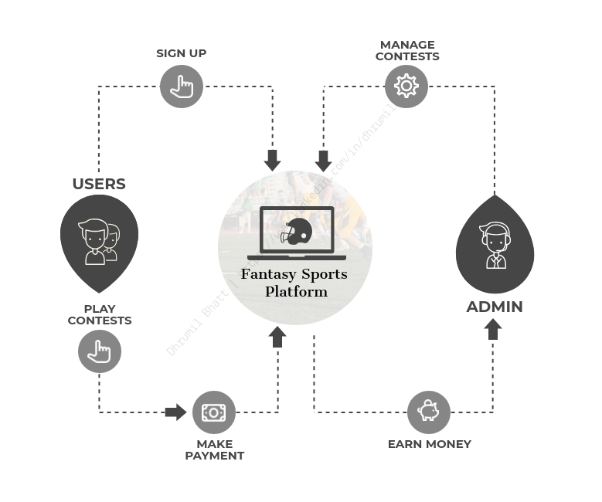
Business Model

Slide 21
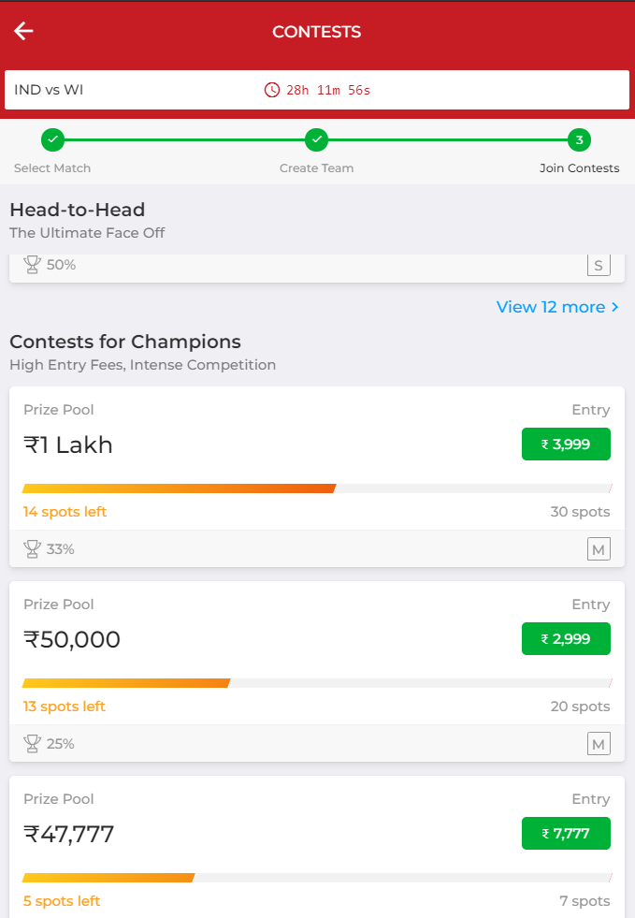
Features
Wide variety of contests available

Slide 22
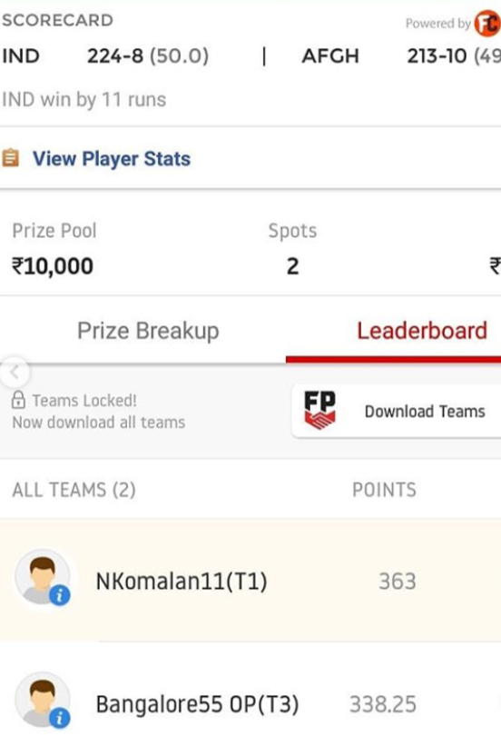
Live match score

Slide 23
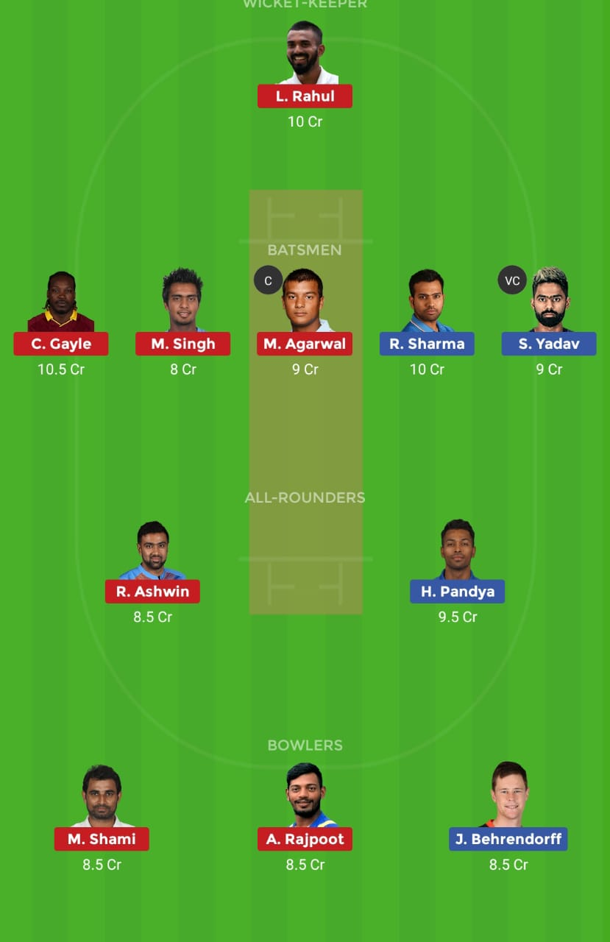
User can create their own fantasy 11 team

Slide 24
Other features
Players can earn money in 2 ways, either by playing fantasy leagues or by referring friends
All platform versions are available
Fantasy leagues of games other than cricket like football, hockey etc are also available
Users can interact with each other

Slide 25
Pros
Allows users to interact with game
It is a prediction scenario where users with good knowledge of game can win money easily
It provides live score
A number of contests are available
Easy to withdraw money
Fantasy leagues of games other than cricket like football, hockey etc are also available

Slide 26
Cons
No score card is depicted
Score updation is slow compared to other apps
Not always accurate
No lite version is available
Contains a lot of ads
Prone to bugs

Slide 27


Slide 28
About
Hotstar is an online video streaming platform owned by Novi Digital Entertainment Private Limited, a wholly owned subsidiary of Star India Private Limited.
Star India officially launched Hotstar in February 2014 after fifteen months of development.
The ad-supported service initially featured a library of over 35,000 hours of content in seven regional languages.

Slide 29
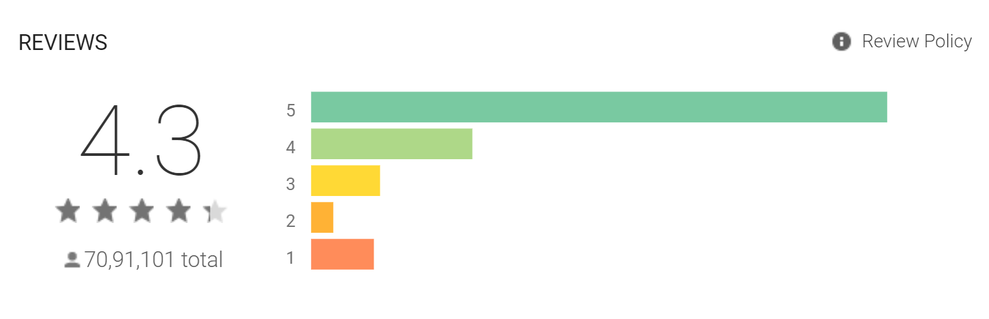
Rating

Slide 30
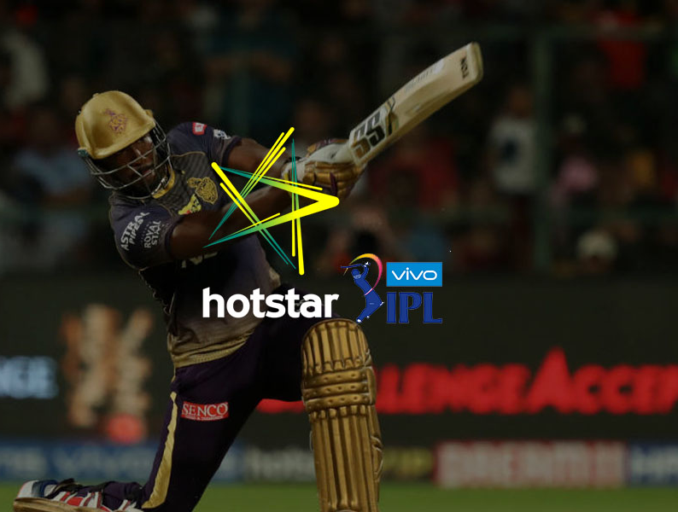
Features
Seamless Video Playback

Slide 31
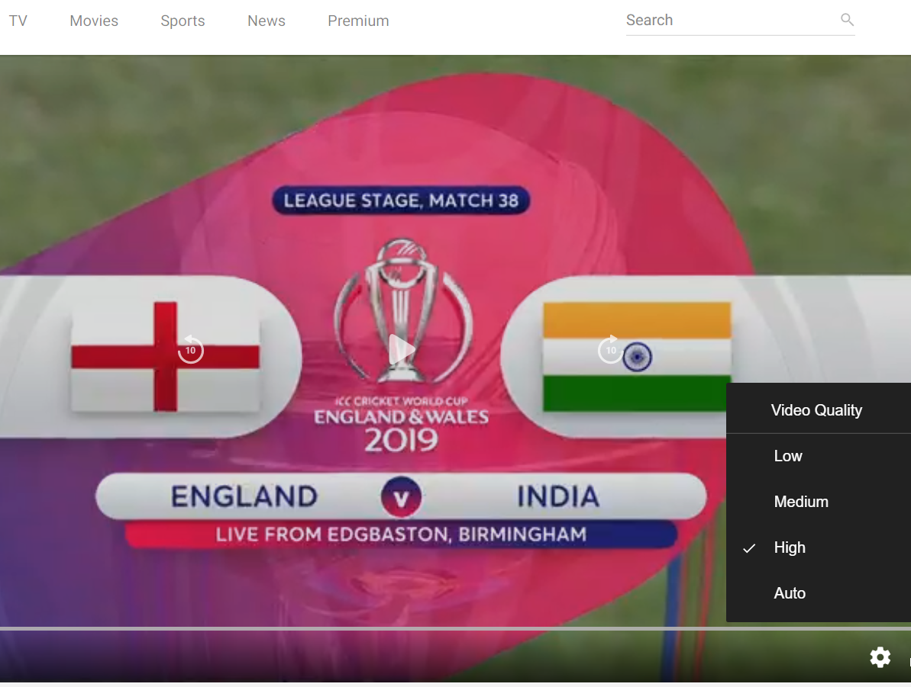
Quality control for all videos

Slide 32
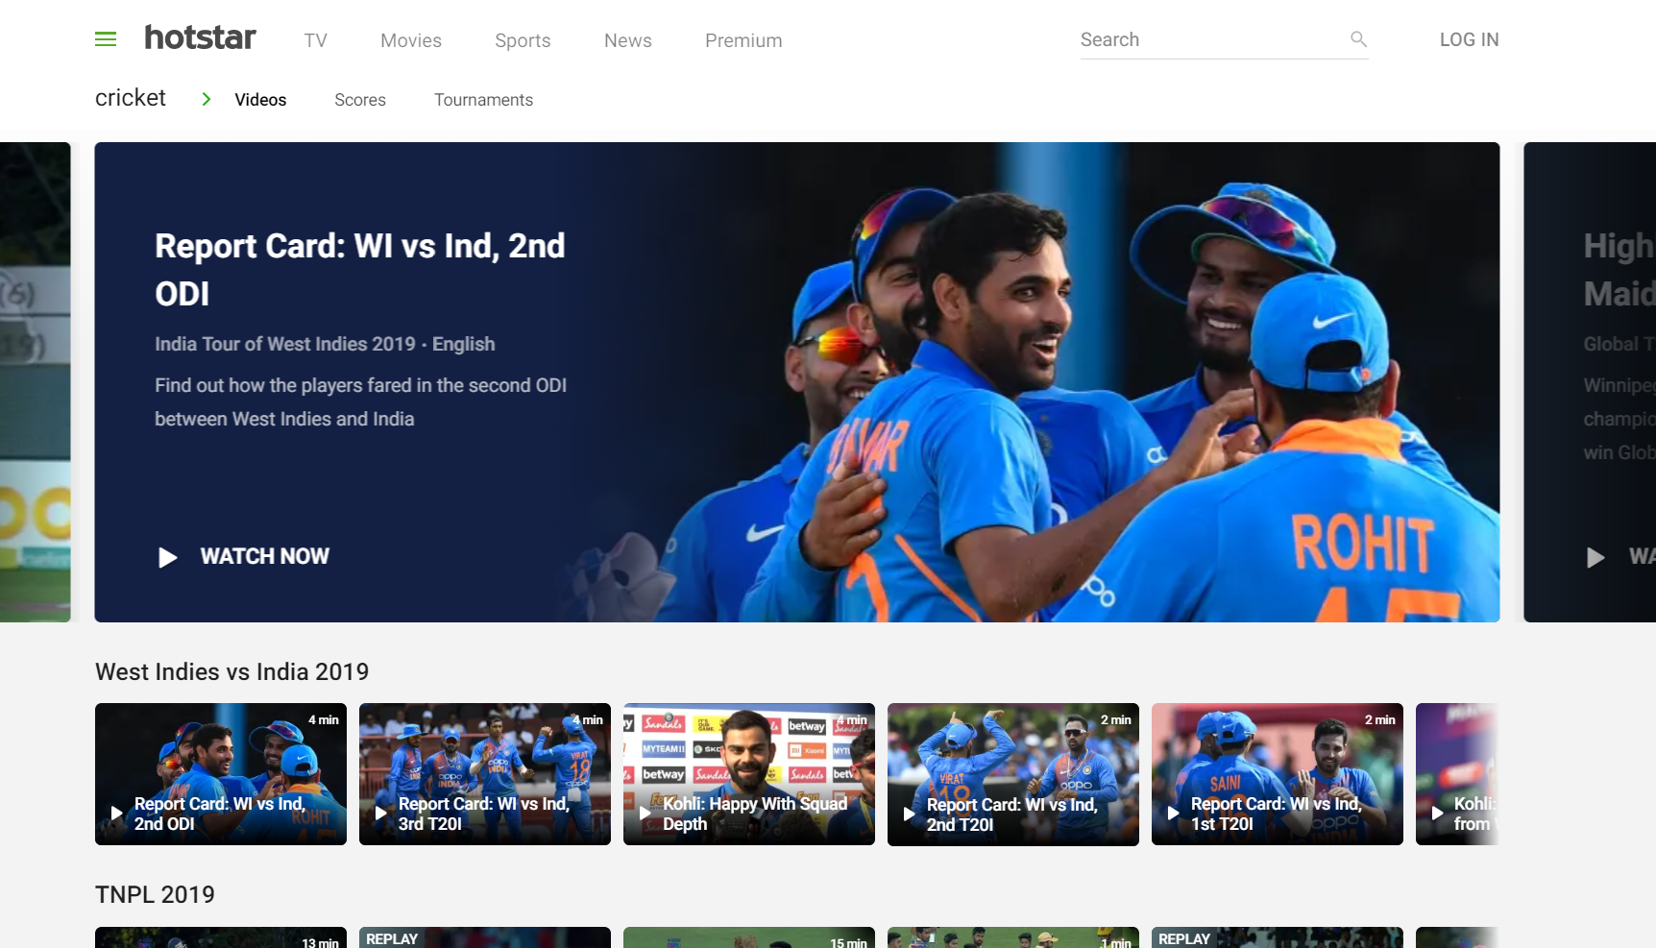
Highlights and report cards of all matches are available

Slide 33
Other features
Smart search facility
Friendly user interface
Offline download possible

Slide 34
Pros
Live streaming of sports
Video quality control
Users can give their comments during the game
Important moments of the match get highlighted
Comparatively less ads within game
Automatic quality control with respect to internet availability

Slide 35
Cons
It is not able to recover from temporary network issues
It uses too much data
If forward or backward button is pressed, it starts buffering all over again
Exclusive aid requires high revenue
Starting of the app is slow
Time lag between real time match and in app match
Not much user support
Can’t check which all devices are logged in with the same account
Only Premium users can view the match without delay

Slide 36

General modifications required

Slide 37
Modifications
Provide a single platform to perform streaming, scorecard depiction and play fantasy league
More personalized with respect to the user
Fast and accuracy
Introduce pin to screen option
Precise notifications
Video quality control
Release lite version

Slide 38
Conclusion We have analyzed the three products in detail and identified the pros and cons of each product. Also looked through the general modifications that can be implemented in the new product.

Slide 39
Thankyou…..

